Slide 1
Human Trafficking Awareness

Slide 2
What is human trafficking?
U.S. law defines human trafficking as the use of force, fraud, or coercion to compel a person into commercial sex acts or labor or services against his or her will.
Human trafficking is the business of stealing freedom for profit. It is a multi-billion dollar criminal industry that denies freedom to 24.9 million people around the world.
Notes:
In some cases, traffickers trick, defraud or physically force victims into providing commercial sex. In others, victims are lied to, assaulted, threatened or manipulated into working under inhumane, illegal or otherwise unacceptable conditions.

Slide 3
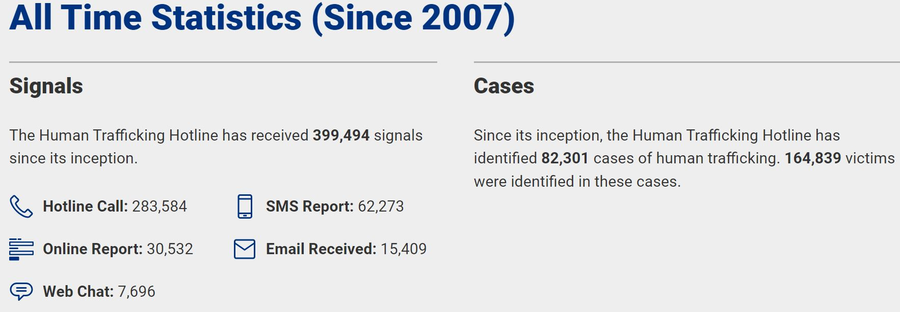
Statistics

Slide 4
What are the signs?

Slide 5
Top 10 Red Flags and Indicators
Individuals selling items or begging
Signs of physical abuse, violence, sleep deprivation, untreated injury, or illness
Groups of traveling sales or work crews sleeping in vehicles in parking lots
Individuals who are being closely monitored by someone
Not allowed to speak for themselves

Slide 6
Top 10 Red Flags and Indicators
Seems fearful or submissive to a person who is speaking for them
Individuals who do not seem to be allowed to come and go on their own
Individuals who do not carry their own identification or money
Mention of working conditions or wages that differ from what was advertised or promised
Mention of unpaid work, unusual work restrictions, or excessively long and/or unusual hours

Slide 7
Who Are The Traffickers?
Traffickers can be strangers, acquaintances, or even family members, and they prey on the vulnerable and on those seeking opportunities to build for themselves a brighter future.
Notes:
At the heart of this phenomenon is the traffickers’ aim to profit from the exploitation of their victims and the myriad coercive and deceptive practices they use to do so.

Slide 8
If you see something, say something

Slide 9
What should you look for?
When talking with a possible victim, watch for:
Timidity
Avoiding eye contact (Keep in mind that in some cultures, people are taught to avoid eye contact)
Dirty clothes
Untreated bruises or other injuries
Not engaging you directly but relying on another to speak for them
Lack of personal belongings
No purse or wallet
Malnourished

Slide 10
What should you look for?
When talking with a possible trafficker, watch for:
Portraying themselves as having a relationship with the victim
Claiming to be a family member or a friend of the family
Look at the body language of the victim and the trafficker
Verbal and non-verbal communication
Look for any indications that the person is in distress

Slide 11
Myth versus Fact

Slide 12
How do you report a suspected case?
Notes:
Explain when each form is used.

Slide 13
Additional Resources
https://humantraffickinghotline.org/en
https://www.justice.gov/humantrafficking/resources
https://www.eeoc.gov/human-trafficking
https://www.floridaallianceendht.com/

Slide 15
For Site Staff Only
Notes:
If you do not work on property, you are welcome to leave the session at this time. Thank you for joining us today!

Slide 16
Human Trafficking Awareness – Required Training
Grace Hill course “Human Trafficking in Rental Housing” course is assigned to all site team members
Take course applicable to your site’s location
If your property is within the State of Florida:
The Certificate of Completion must be printed and given to the Community Manager for each site employee
All certificates must be kept in an easily accessible location for your annual inspection by the Department of Business & Professional Regulation

Slide 17
Human Trafficking Awareness (Florida)
Statute 509.096: Human trafficking awareness training and policies for employees of public lodging establishments; enforcement —
A public lodging establishment shall:
(a) Provide annual training regarding human trafficking awareness to employees of the establishment who perform housekeeping duties in the rental units or who work at the front desk or reception area where guests ordinarily check in or check out. Such training must also be provided for new employees within 60 days after they begin their employment in those roles, or by January 1, 2021, whichever occurs later. Each employee must submit to the hiring establishment a signed and dated acknowledgment of having received the training, which the establishment must provide to the Department of Business and Professional Regulation upon request. The establishment may keep such acknowledgment electronically.

Slide 18
Human Trafficking Awareness (Florida)
Post in a conspicuous location in the establishment which is accessible to employees a human trafficking public awareness sign at least 11 inches by 15 inches in size, printed in an easily legible font and in at least 32-point type, which states in English and Spanish, and any other language predominantly spoken in that area which the department deems appropriate substantially the following:
“If you or someone you know is being forced to engage in an activity and cannot leave, whether it is prostitution, housework, farm work, factory work, retail work, restaurant work, or any other activity, call the National Human Trafficking Resource Center at 888-373-7888 or text INFO or HELP to 233-733 to access help and services. Victims of slavery and human trafficking are protected under United States and Florida law.”

Slide 19
Human Trafficking Awareness (Florida)
The human trafficking awareness training required under paragraph 1)(a) must be submitted to and approved by the Department of Business and Professional Regulation and must include all of the following:
(a) The definition of human trafficking and the difference between the two forms of human trafficking: sex trafficking and labor trafficking.
(b) Guidance specific to the public lodging sector concerning how to identify individuals who may be victims of human trafficking.
(c) Guidance concerning the role of the employees of a public lodging establishment in reporting and responding to suspected human trafficking.

Slide 20
Human Trafficking Awareness (Florida)`
The division shall impose an administrative fine of $2,000 per day on a public lodging establishment that is not in compliance with this section and remit the fines to the direct-support organization established under s. 16.618, unless the division receives adequate written documentation from the public lodging establishment which provides assurance that each deficiency will be corrected within 90 days after the division provided the public lodging establishment with notice of its violation.
This section does not establish a private cause of action. This section does not alter or limit any other existing remedies available to survivors of human trafficking.

Slide 21
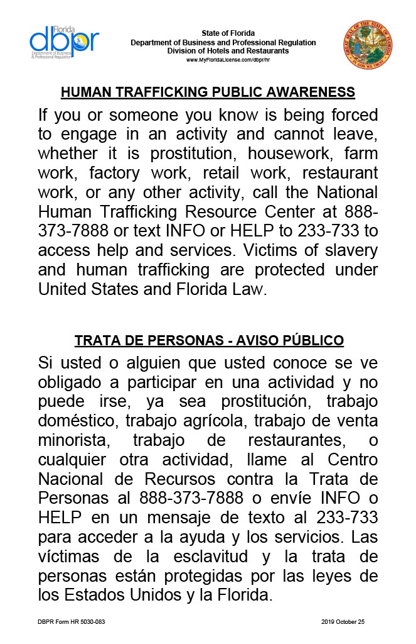
Sign Required – State of FL
Sign available under Chapter 1: Operations Procedures

Slide 22
Questions?

Slide 23
Notes:
Thank you to all for joining us today! Here is some motivation to take with you. Thank you for all that you do – we appreciate you!

Slide 24
For training related needs please reach out to training@royalamerican.com

